Slide 1
An Overview to Programming Simple Games

Slide 2
Instructor – Ray Smith raysmith@alum.mit.edu
Many years of Programming – engineering, scientific, financial
Commercial, Scientific, Systems Languages – C, C++, Perl, Java, Python, Assembly
NEW Areas – Support the Blind
Notes:
What would you like to know about me?

Slide 3
What Games ? – Simple
2-D Car Race
Sudoku puzzle solving
Squares, twenty questions
NOT high performance
NOT Multiperson shooters
NOT AI, GPT

Slide 4
Examples
Cars – simple 2-D track design
Sudoku – display solution
Pool – Simple 2-D pool display
Twenty Questions – simplest text base
Knight traversal – display solution process
Chess game – support display of game
Squares – display of simple play
Notes:
What would you like to know about me?

Slide 5
Your Game Requirements
What sort of game?
Textual, graphic, animated, sounds
What Audience?
Adult, Child, Sports
Challenged: Sighted, visually impaired,
Totally blind
Multiple group support – Sighted+blind
Notes:
Why Games – fun, concentrate on the issues

Slide 6
Game Requirements - continued
Tools / Environment
Keyboard, monitor(s), speakers, headphones: mono, stereo
Tablets, smart phone, special controlers
Multiple setups: optional, required
Notes:
Audience often influences these.

Slide 7
Game Requirements - continued
Programming Languages
Python – easy – our examples
C++ - high performance
Java – widespread
Java Script - WEB
HTML - WEB
Notes:
Just the tools, not the goal.

Slide 8
Game Requirements - continued
Programming Environment / Tools
Visual Studio Code (VSCODE)
PyCharm
Graphics Libraries
Tkinter – comes with Python
wxPython – requires installation
Notes:
Speed the process. But don’t let them be the goal.

Slide 9
Game Requirements – Choose Game
What’s interesting/important/necessary
View/sound/animation
Interaction
People vs people
People vs computer
Computer vs computer
Reproducible, record, playback
Stage progress - what’s first, easy, hard
Notes:
Don’t need the whole answer at once.

Slide 10
Game Progress - Iteration
Learn as you go
Build two and throwaway the first
the Mythical Man-Month – Frederick P. Brooks, Jr.
Chapter 11. Plan to Throw One Away
Test as much as you can
Automated is expensive but worth it.
Graphics testing is hard but can be done.
Notes:
What do you want to learn/show/prove?

Slide 11
Some Samples
Bare Prototypes
Limited Features
Showing principles
Concepts / Style
https://github.com/raysmith619
Notes:
Learning examples.

Slide 12
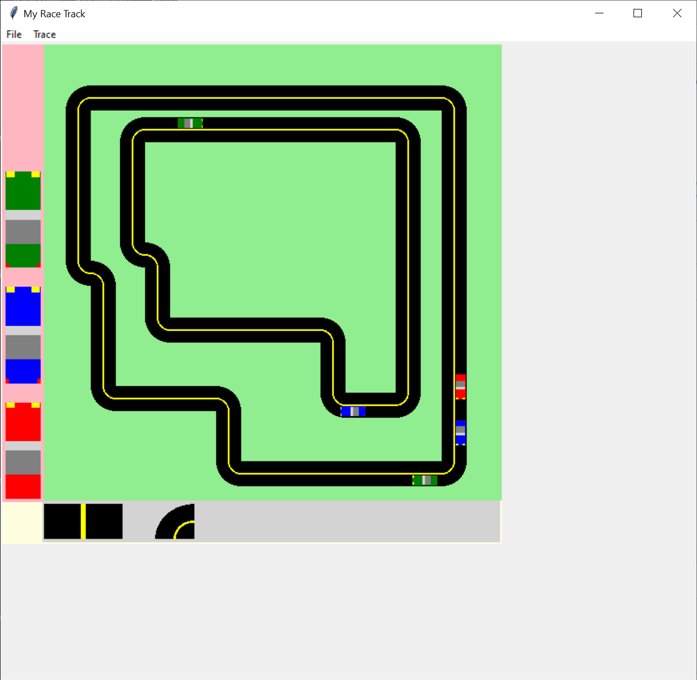
race_track
Notes:
What would you like to know about me?

Slide 13
race_track
Construction Game – like toy blocks
Build simple racing tracks
straight tracks and turns
Placing simple cars
Not much Driving Control
github…/race_track-master
Notes:
Looking an interesting part – track building.

Slide 14
race_track Ideas
Simple 2-D Display
Hierarchical Operation
BlockBlock → CarBlock, RoadBlock
RoadBlock → RoadStraight, RoadTurn
Hierarchical Graphical Construction
BlockBlock: POLYGON, LINE, ARC or Composite(group of above)
Notes:
Generalized building / constructing, geometric collections

Slide 15
race_track Ideas
Undo/Redo support
More than one way
We use a Command Paradigm
Each action is a command
Command supports do(), undo()
Action
executes command.do()
pushes command on command stack
Notes:
One often wants to “undo” their last action(s) or undo their last undo ☺
Very common in programs such as word processors, data entry…
Choices often depend on the amount of information (state) changing per move.
Stack, often called last-in, first-out queue
like elevator – last in, first out
useful when one stores things over time, wanting to get the last thing stored

Slide 16
race_track Ideas
Undo / Redo continued
Undo
pop off command stack
execute command.undo()
push command on undo stack
Redo
pop off undo stack
execute command.do()
Push command on command stack

Slide 17
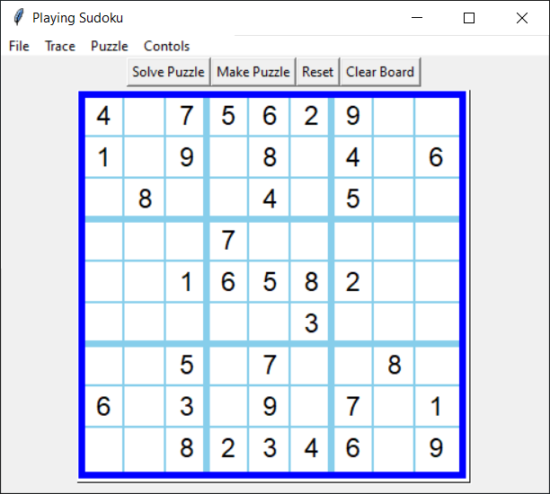
Sudoku – Puzzle Solver
Notes:
Simple rules: Use digit only once in line (up, sidways)
Use digit only once in sub box(3by3)

Slide 18
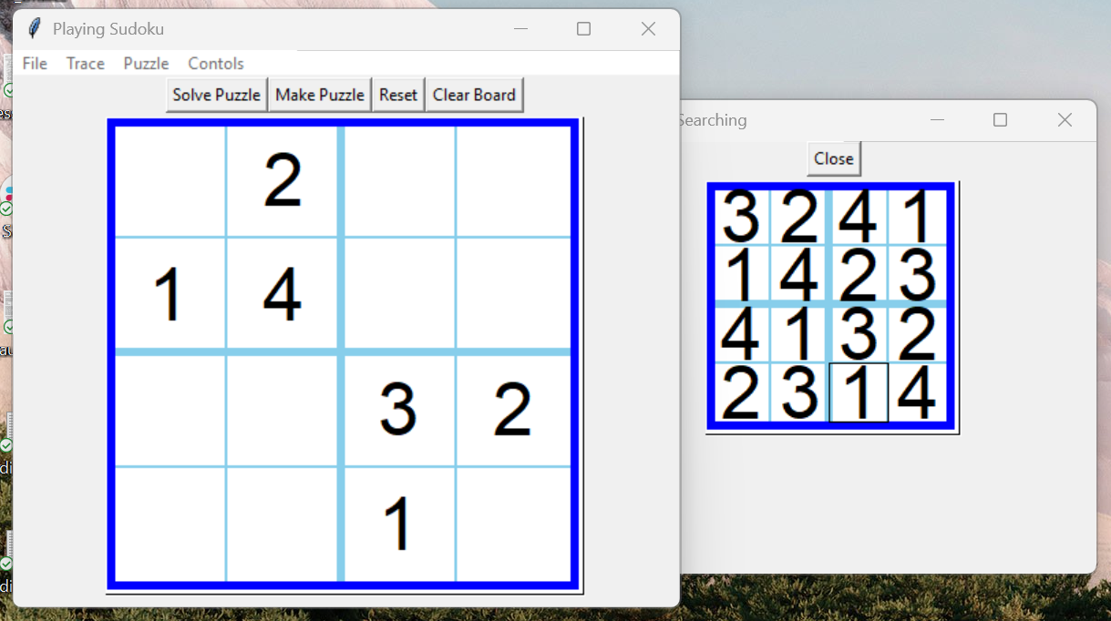
Sudoku – Puzzle Solver
Notes:
Generalization: support 4by4,, 2by2, 1by1☺

Slide 19
Sudoku
Problem Solver
Solution / Analysis Display
Game Storage
github…/sudoku-master

Slide 20
Sudoku – Solution Algorithm - Simple
Find candidates for empty cells
Recursively
Choose candidate in empty cell
Solve resulting puzzle
If no solution, backup and try next candidate

Slide 21
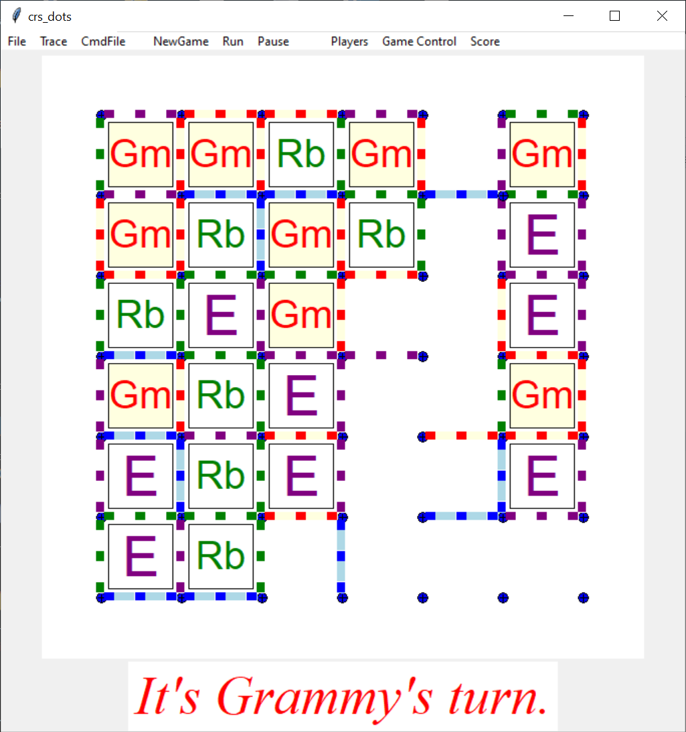
Connect the Dots
Notes:
Each person, in turn, connects a pair of adjacent dots (vertically or horizontally)
Upon completing a square, that person labels the square and takes(must) another turn.

Slide 22
Connect the Dots
“board game”, like Tic-tac-toe
Play and display
Display player’s symbol on squares
Multiple players
Player vs. player or vs machine
Letter or picture image
github…/dots
Notes:
What would you like to know about me?

Slide 23
Connect the Dots - Features
Customizable player setup, including manual/automatic specification
Board dimensions specifiable
Support both mouse and keyboard player operation
Player move Do / Undo
Multiple game playing for statistics generation
Recorded game results
Game results processing and analysis
github…/dots

Slide 24
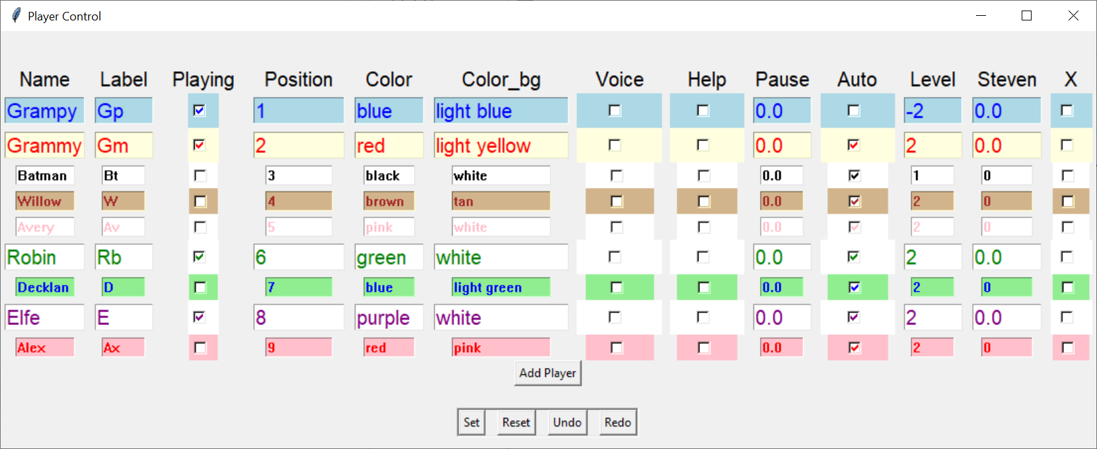
Connect the Dots – Player setup
Notes:
Undo/Redo – across sessions

Slide 25
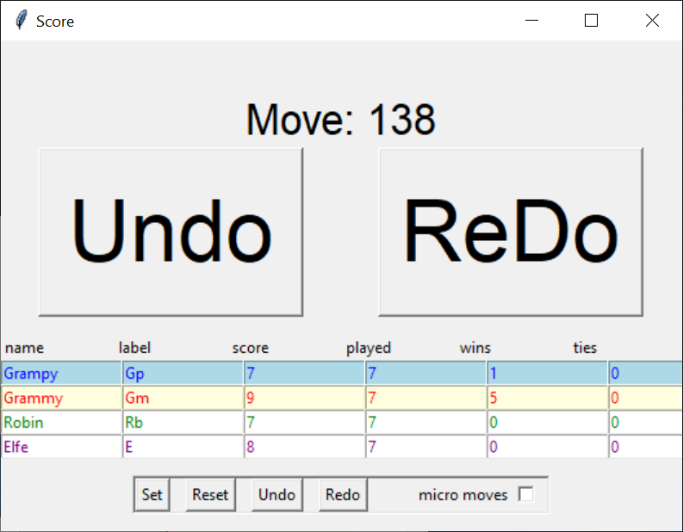
Connect the Dots – Game Control
Notes:
Not showing losses?

Slide 26
Question and Answer

